Slide 1
Automation APIs in QSEoW
Repository API, Proxy API
July 2020
Levi Turner
Senior Enterprise Architect

Slide 2


What are RESTful APIs
REpresentational State Transfer
Stateless
HTTP Verbs (GET, POST, PUT, DELETE)
Uniform Interface
GET /qrs/app, /qrs/user
request
response
request
response
request
response

Slide 3

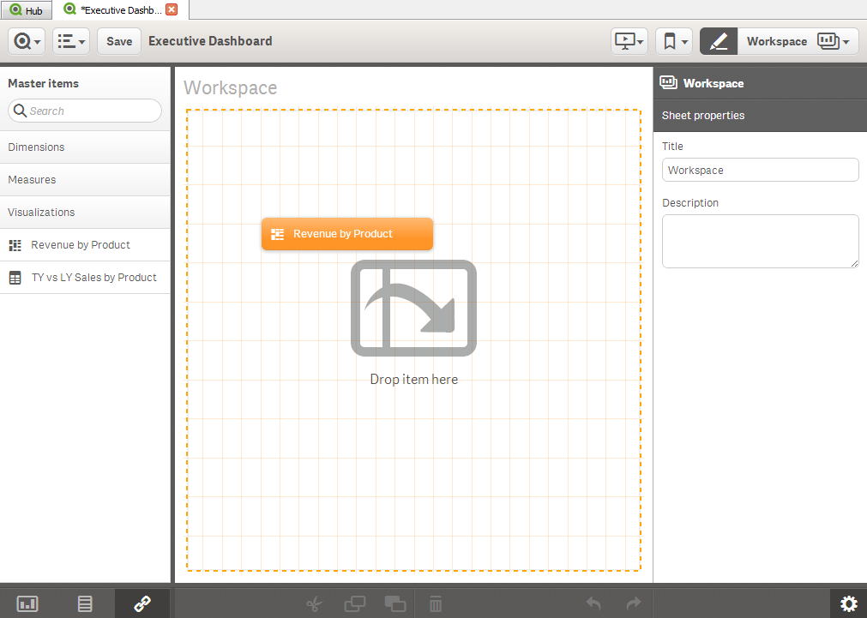
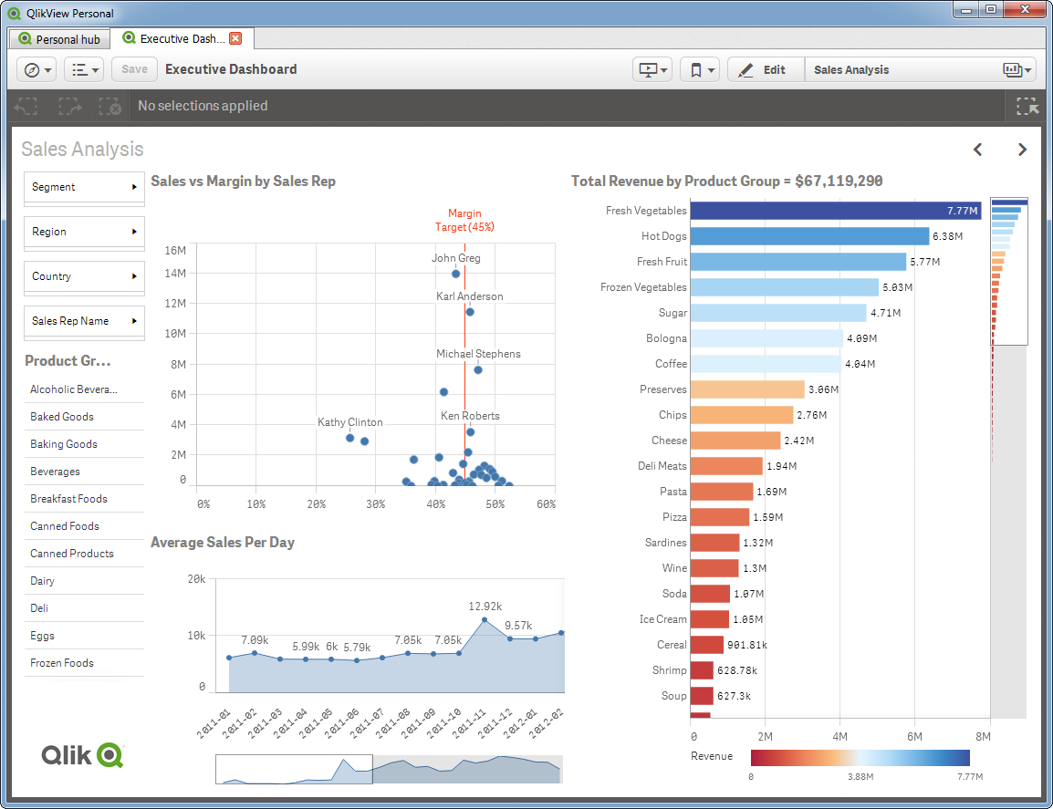





API / SDK
Qlik Sense Platform APIs
Qlik Sense Extension API
Create New Visualizations
Qlik Sense Application, Integration, Capability APIs / .NET SDK
REST / JSON Based APIs
JavaScript, HTML5, CSS3 for Extensions and Mashups
.NET based DLLs and libraries for SDKs (Mashup / QVX)
Same APIs Qlik Sense product uses
Web App
Hub
Embed Visualizations and functionality
Qlik Sense Proxy Service API
Authentication, Load Balancing,
Session Management
Proxy
Qlik Sense Engine / Backend API
Communicate Directly with Engine
Qlik Sense Repository Service API
Engine
Management, Scheduling, Administration
Qlik Sense User Directory Connector API
Create Custom User Directory Connectors
Repository
Scheduler
Applications
Qlik Sense QVX SDK
Create Custom Data Connectors

Slide 4


What are they used for?
Repository API:
Managing asset metadata
Reloads
Entitlements
Proxy API:
Creating / viewing user sessions

Slide 5

Authentication & Authorization
Directly to Qlik Repository Service
Uses port 4242
Authentication uses internal certificate
Authorization based on required header
Using Qlik Proxy Service
Uses HTTPS/HTTP Port, default 443
Uses configured authentication
Authorization based on authenticated user
Uses a "session"

Slide 6
Use Cases
Directly to Qlik Repository Service
Back-end processes
Trusted systems
Productionalized code
Using Qlik Proxy Service
Integration in authentication systems
Web Integrations
Use on untrusted systems

Slide 7
Request Structure
Authentication Stuff
Verb
Endpoint (and parameters):
Headers:
Body (optional)
GET, POST, PUT, DELETE
/qrs/about?xrfkey=1234567890ABCDEF
Content-Type: application/json (only for PUT/POST)
X-Qlik-xrfkey: 1234567890ABCDEF
X-Qlik-user: userDirectory=INTERNAL;UserId=sa_api
{
"foo": "bar",
"enabled": true
}

Slide 8
Consistency across entity
Method | What it does | Example
GET | Retrieve | /qrs/{entity}
POST | Create | /qrs/{entity}
PUT | Update | /qrs/{entity}/{id}
DELETE | Remove | /qrs/{entity}/{id}

Slide 9
Helper APIs
Endpoint | Return
/qrs/about/openapi/main | Full API Spec
/qrs/about/api/relations | Relationship between Entities
/qrs/about/api/description | Get all QRS Endpoints
/qrs/about/api/default/{entity} | Get blank example of structure
/qps/about/description | Get all QPS Endpoints

Slide 10
Lesser Known but Powerful APIs
POST /qrs/notification
Use Case: Do something if something happens inside of Qlik Sense Enterprise
Example: https://github.com/eapowertools/qs-event-driven-cross-site-app-promoter
POST /qrs/externalprogramtask
Use Case: Call a script from Qlik Sense Enterprise. Potentially chained to app reloads
Example (1): Scrape App Metadata → Reload app off that metadata (Telemetry)
Example (2): Reload App → Cache Warm app

Slide 11
Actual Code
POST /qrs/notification
Body
"http://localhost:5001/notify"
POST /qrs/externalprogramtask
Body
{ "path": "C:\\Windows\\System32\\WindowsPowerShell\\v1.0\\powershell.exe", "parameters": " -ExecutionPolicy Bypass C:\\scripts\\powerShell\\example.ps1", "name": "ExampleTask-ExternalProgramTask", "taskType": 1, "enabled": true, "taskSessionTimeout": 1440, "maxRetries": 0, "schemaPath": "ExternalProgramTask“ }

Slide 12
Tips & Tricks
Updates?
GET → Do your planned changes → Modify modifiedDate property → PUT
Access is granted based on context (Hub vs. QMC vs. Both
X-Qlik-Security: Context=ManagementAccess / AppAccess
Consistency check in your scripts
Typical flow is
GET /qrs/{entity}/full?filter=myFilter eq 'foo’
Check the count here
GET /qrs/{entity}/{id}
…

Slide 13



Helper Libraries
qrs-interact
qsAPI
Qlik-Cli-Windows

Slide 14





More resources
 | developer.qlik.com is Qlik’s open source community
 | community.qlik.com has many different resources and solutions
 | #slack you can find the invite on developer.qlik.com
 | github.com hosts many of Qlik’s open source solutions
 | getpostman.com great testing tool for REST endpoints
 | help.qlik.com has documentation for all Qlik APIs as well as some examples to reference

Slide 15
Links
Stuff I’ve done:
https://github.com/levi-turner
https://gist.github.com/levi-turner
https://github.com/eapowertools/
Files from this session:
https://github.com/levi-turner/qlik_integration_meetup

